Slide 1
MODULE 5
System Development Process

Slide 2
Identifying and selecting Information System (IS) development projects
Identifying and selecting Information System (IS) development projects
Project identification and selection consists of three primary activities: identifying potential development projects, classifying and ranking projects, and selecting projects for development.
1. Identifying potential development projects. Organizations vary as to how they identify projects. This process can be performed by:
A key member of top management, either the CEO of a small or medium-size organization or a senior executive in a larger organization
A steering committee, composed of a cross section of managers with an interest in systems

Slide 3
Cont…
User departments, in which either the head of the requesting unit or a committee from the requesting department decides which projects to submit (as a systems analyst, you will help users prepare such requests)
The development group or a senior IS manager
Each identification method has strengths and weaknesses. For example, projects identified by top management have a strategic organizational focus. Alternatively, projects identified by steering committees reflect the diversity of the committee and therefore have a cross-functional focus.
Projects identified by individual departments or business units have a narrow, tactical focus. The development group identifies projects based on the ease with which existing hardware and systems will integrate with the proposed project. Other factors, such as project cost, duration, complexity, and risk, also influence the people who identify a project.

Slide 4
2. Classifying and ranking IS development projects.
Assessing the merit of potential projects is the second major activity in the project identification and selection phase. As with project identification, classifying and ranking projects can be performed by top managers, a steering committee, business units, or the IS development group. The criteria used to assign the merit of a given project can vary based on the size of the organization.
As with project identification, the criteria used to evaluate projects will vary by organization. If, for example, an organization uses a steering committee, it may choose to meet monthly or quarterly to review projects and use a wide variety of evaluation criteria. At these meetings, new project requests are reviewed relative to projects already identified, and ongoing projects are monitored. The relative ratings of projects are used to guide the final activity of this identification process—project selection.

Slide 5
3. Selecting IS development projects.
The selection of projects is the final activity in the project identification and selection phase. The short- and long-term projects most likely to achieve business objectives are considered. As business conditions change over time, the relative importance of any single project may substantially change. Thus, the identification and selection of projects is an important and ongoing activity.
Numerous factors must be considered when selecting a project
Perceived needs of the organization
Existing systems and ongoing projects
Resource availability
Evaluation criteria
Current business conditions
Perspectives of the decision makers

Slide 6
Cont…
This decision-making process can lead to numerous outcomes. Of course, projects can be accepted or rejected. Acceptance of a project usually means that funding to conduct the next SDLC activity has been approved.
Rejection means that the project will no longer be considered for development. However, projects may also be conditionally accepted; projects may be accepted pending the approval or availability of needed resources or the demonstration that a particularly difficult aspect of the system can be developed. Projects may also be returned to the original requesters who are told to develop or purchase the requested system themselves. Finally, the requesters of a project may be asked to modify and resubmit their request after making suggested changes or clarifications.

Slide 7
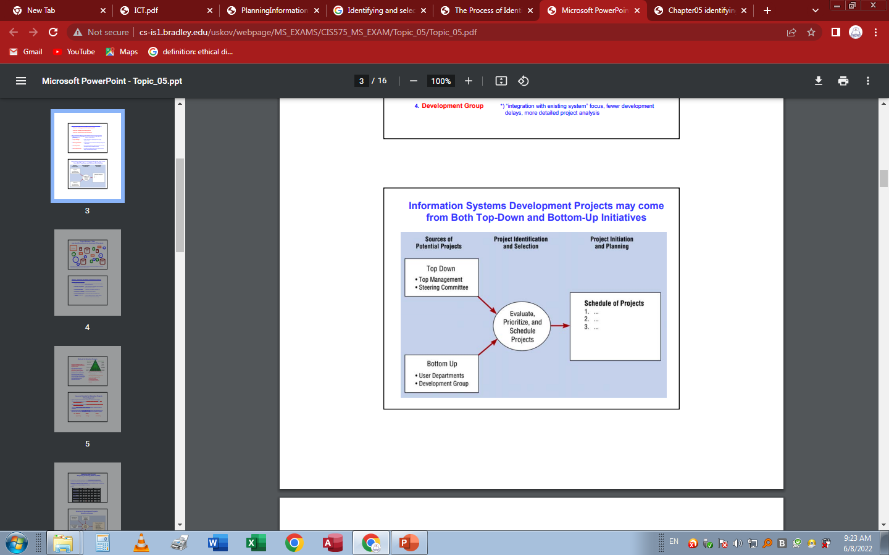
Deliverables and Outcomes
The primary deliverable, or end product, from the project identification and selection phase is a schedule of specific IS development projects. These projects come from both top-down and bottom-up sources, and once selected they move into the second activity within this SDLC phase—project initiation and planning.
The top-down approach to management is when company-wide decisions are made solely by leadership at the top, while the bottom-up approach gives all teams a voice in these types of decisions.

Slide 8
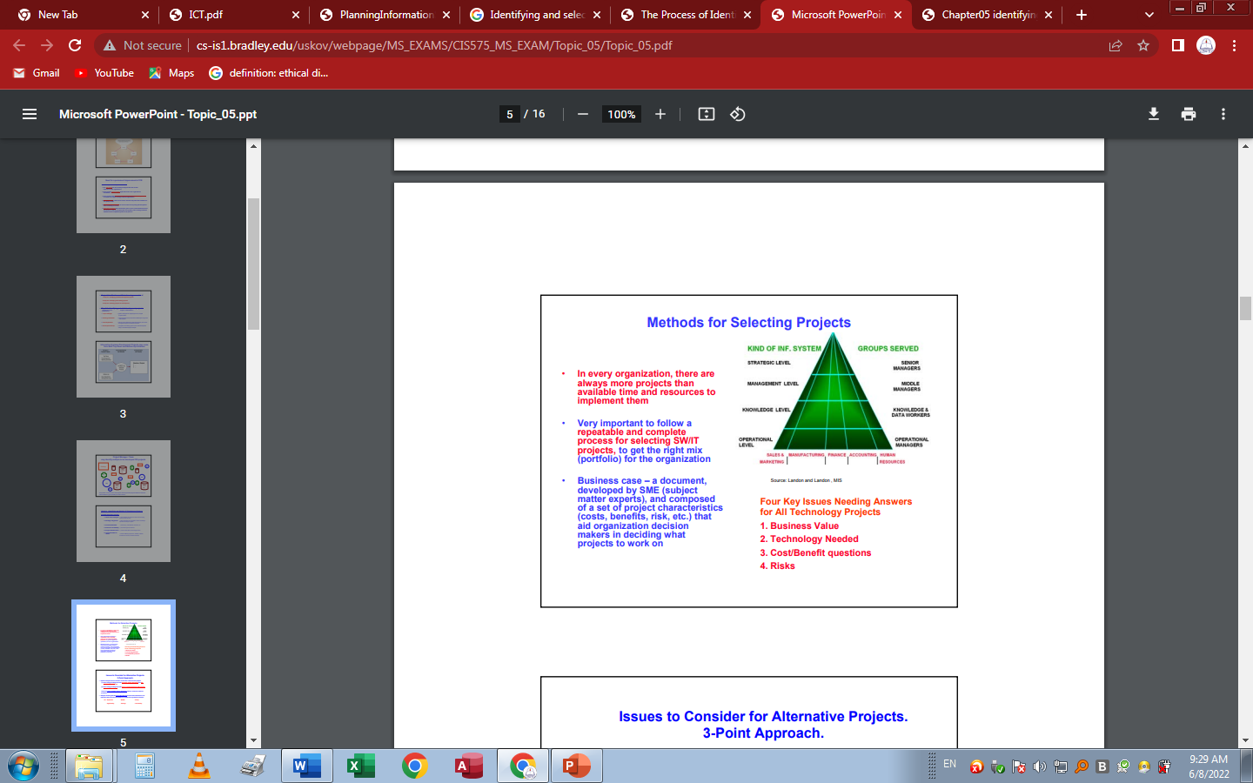
Cont…

Slide 9
INFORMATION SYSTEMS PLANNING
Information systems planning
Information systems planning (ISP) is a process of defining objectives for organizational computing and identifying suitable potential information technology (IT) applicable to the company.
One has to plan the information which the management information system will churn out for the different levels of management. The report structures, information flow, storage, information capture and its strategy, network, applications and security are all planned and designed before the system is created.
Normally, the stages of MIS development conform to a stage-wise development approach, with planning of the system being the first activity followed by analysis and design which in turn is followed by coding, testing and implementation.

Slide 10
Cont…
However, even though the broad stages may be used for most MIS development, the order is sometimes tweaked. Each of the activities given above for development of MIS is a difficult and intellectually stimulating set of tasks requiring technical and managerial skills. In some of the activities, the users are actively involved in arriving at the design of the system.
Normally, the system analyst and his team will be responsible for the majority of the stages in developing the management information system. This is required as the development process requires knowledge of both management and technology which most line manager’s lack.
Information systems development becomes easy if there is:
A supportive management with a positive attitude
The existing IS is adequate
The objectives for the new IS are good and clear

Slide 11
Cont…
In such a scenario, the IS development becomes easy and the IS that is developed delivers value and becomes acceptable to employees easily. However, if any or all of the above factors are not in favor, i.e., management is not supportive or has a negative attitude towards IS or if the objectives of the new IS are bad or if the existing IS is inadequate or all of the factors are together not in favor, then the IS development becomes very difficult.
The Process of Development of Information System: A Typical Software Development Life Cycle
The process of development of information systems in an organization may vary from case to case but ideally the stages of development can be clearly demarcated. The process of development of information system involves the following stages:

Slide 12
Cont…
Planning-planning is required as without planning the outcome will be below expectations. Planning sets the objectives of the system in clear and unambiguous terms so that the developer may conform to a well laid set of deliverables rather than a high-sounding statement that may mean little to him. Planning also enables the development process to be structured so that logical methodology is used rather than working in fits and starts. It ensures user participation and helps in greater acceptability and a better outcome from the development process. It leads to a system that is well balanced in both the managerial and technical aspects.
Analysis-is an activity of technical representation of a system. Over the years many methods have been developed of which the structured analysis and object oriented analysis are most widely used. This step or activity is the first technical representation in abstract terms of the system.

Slide 13
Cont…
Design-is the stage where the model or representation of an entity or a system is done (in detail). It is based on the idea that the developer will be able to develop a working system conforming to all the specifications of the design document which would satisfy the user. ·It is a concept which has been borrowed from other branches in engineering where the blueprint of a system or entity to be built later is first created on a piece of paper or digitally to help developers in conceptualization of the system and to understand the specifications of the system.
Coding-is the actual stage of writing codes to develop the application software according to the specifications as set by the design document. The programming done at this stage to build the system is dictated by the needs of the design specifications. The programmer cannot go beyond the design document.
Testing-is the testing of the system to check if the application is as per the set specification and to check whether the system will be able to function under actual load of data. The testing is also done to remove any bugs or errors in the code.

Slide 14
Cont…
Implementation-is the stage when the system is deployed in the organization. This is a process which often is a difficult one as it involves some customization of the code to fit context specific information in the system.
Before commencing IS planning, one must also identify the need for new information system. The above figure gives a flow chart to find out if the existing IS is fulfilling the objectives of the organization with respect to IS. Sometimes, an existing IS can be tweaked or redesigned to align it with the changing objectives and business needs of the organization but sometimes, that become too costly or technically infeasible, in which case, one has to start the process for a new IS. The above flowchart also gives us a tool to use to understand whether our existing IS is relevant for our business operations.

Slide 15
INITIATING AND PLANNING IS PROJECTS
Initiating and planning IS projects
Project initiation is the first step in starting a new project. During the project initiation phase, you establish why you’re doing the project and what business value it will deliver—then use that information to secure buy-in from key stakeholders.
The term “project initiation” comes from a five-phase model created by the Project Management Institute (PMI). PMI outlines this model in their Guide to the Project Management Body of Knowledge, also known as the PMBOK® Guide. The model divides a project’s lifecycle into these five stages:
Project initiation: Broadly define your project and secure buy-in.
Project planning: Create detailed goals and a project roadmap.
Project execution: Launch your project using information from the first two steps.
Project performance: Measure effectiveness using key performance indicators (KPIs).
Project closure: Debrief with stakeholders.

Slide 16
Cont…
The project initiation phase is the first phase within the project management life cycle, as it involves starting up a new project. Within the initiation phase, the business problem or opportunity is identified, a solution is defined, a project is formed, and a project team is appointed to build and deliver the solution to the customer. A business case is created to define the problem or opportunity in detail and identify a preferred solution for implementation. The business case includes:
A detailed description of the problem or opportunity with headings such as Introduction, Business Objectives, Problem/Opportunity Statement, Assumptions, and Constraints
A list of the alternative solutions available
An analysis of the business benefits, costs, risks, and issues
A description of the preferred solution
Main project requirements
A summarized plan for implementation that includes a schedule and financial analysis

Slide 17
Cont…
The project sponsor then approves the business case, and the required funding is allocated to proceed with a feasibility study. It is up to the project sponsor to determine if the project is worth undertaking and whether the project will be profitable to the organization. The completion and approval of the feasibility study triggers the beginning of the planning phase. The feasibility study may also show that the project is not worth pursuing and the project is terminated; thus the next phase never begins.
The success of your project depends on the clarity and accuracy of your business case and whether people believe they can achieve it. Whenever you consider past experience, your business case is more realistic; and whenever you involve other people in the business case’s development, you encourage their commitment to achieving it.
The project initiation process: 4 steps to get started
1. Create a project charter or business case
In this first step, you demonstrate why your project is necessary and what benefit it will bring. You can do this with either a project charter or a business case.

Slide 18
Cont…
These two documents follow the same fundamental idea, since they’re both used to outline key project details and pitch your initiative to stakeholders. The main difference between them is scope—you can use a project charter for smaller initiatives, and a business case for larger projects that require significant resources. For example, you might create a project charter for a redesign of your company homepage, and a business case for a company-wide rebrand.
Project charter
A project charter demonstrates why your project is important, what it will entail, and who will work on it—all through the following elements:
Why: The project’s goals and purpose
What: The scope of the project, including an outline of your project budget
Who: Key stakeholders, project sponsors, and project team members

Slide 19
Cont…
Business case
A business case includes all the components of a project charter, along with these additional elements:
A comprehensive financial analysis, including an estimate of the return on investment (ROI) your project will bring
An analysis of project risks and a risk management plan
An action plan that includes how decisions will be made (such as a RACI chart), a communication plan, and next steps you’ll take if your business case is approved
2. Identify key stakeholders and pitch your project
Next up, determine who needs to sign off on your project charter or business case. This includes key stakeholders who have a say in the outcome of your project—for example, executive leaders, project sponsors, or cross-functional teams that you’re requesting budget or resources from.
If you’re not sure who your key stakeholders are, ask yourself the following questions:
Who needs to approve my project?
Who will provide resources for my project?
Who can influence my project?

Slide 20
Cont…
You can also create a project stakeholder analysis to ensure you’re not overlooking any important players. This methodology involves dividing stakeholders into four main groups: those with high influence and high interest, high influence and low interest, low influence and high interest, and low influence and low interest. Anyone in the first bucket (high influence and high interest) is likely a key stakeholder that should approve your project during the initiation phase.
3. Run a feasibility study
At this point you’ve pitched your project, demonstrating that it adds value and fits with your company’s overall strategic plan. Now, it’s time to run a feasibility study to confirm your project is possible with the resources you have at your disposal.
Simply put, a feasibility study evaluates whether your project could be successful. It answers the following questions:
Does my team have the required resources to complete this project?
Will there be enough return on investment (ROI) to make this project worth pursuing?

Slide 21
Cont…
If you can answer yes to both questions, you have a solid rationale to move forward with your project. If your feasibility study concludes that you don’t have enough budget or resources, you’ve created a strong case to go back to stakeholders and request more. And if your project’s ROI isn’t up to snuff, you can use that data to tweak your project plan—or pursue a different opportunity entirely.

Slide 22
FEASIBILITY ASSESSMENT
Feasibility assessment:
A feasibility assessment is a study to determine if the requirements of a project or a program can be met within the cost, schedule, and performance constraints of the project or program.
Economic feasibility/ Financial feasibility.
Financial feasibility describes whether or not your project is fiscally viable. A financial feasibility report includes a cost/benefit analysis of the project. It also forecasts an expected return on investment (ROI), as well as outlines any financial risks. The goal at the end of the financial feasibility study is to understand the economic benefits the project will drive.
The objective of the economic feasibility is to develop a financial model of the business venture.
The product of this step is a complete integration of the technical product information and the market study into one or more break-even financial models.

Slide 23
2. Technical feasibility
A technical feasibility study reviews the technical resources available for your project. This study determines if you have the right equipment, enough equipment, and the right technical knowledge to complete your project objectives. For example, if your project plan proposes creating 50,000 products per month, but you can only produce 30,000 products per month in your factories, this project isn’t technically feasible.
3. Market feasibility
The market feasibility study is an evaluation of how your team expects the project’s deliverables to perform in the market. This part of the report includes a market analysis, market competition breakdown, and sales projections.
4. Operational feasibility
An operational feasibility study evaluates whether or not your organization is able to complete this project. This includes staffing requirements, organizational structure, and any applicable legal requirements. At the end of the operational feasibility study, your team will have a sense of whether or not you have the resources, skills, and competencies to complete this work.

Slide 24
Cont…
Creating a clear feasibility study helps project stakeholders during the decision making process.
A feasibility study contains:
An executive summary describing the project’s overall viability
A description of the product or service being developed during this project
Any technical considerations, including technology, equipment, or staffing
The market survey, including a study of the current market and the marketing strategy
The operational feasibility study, evaluating whether or not your team’s current organizational structure can support this initiative
The project timeline
Financial projections based on your financial feasibility report

Slide 25
6 steps for conducting a feasibility study
Run a preliminary analysis
Creating a feasibility study is a time-intensive process. Before diving into the feasibility study, it’s important to evaluate the project for any obvious and insurmountable roadblocks.
2. Evaluate financial feasibility
Think of the financial feasibility study as the projected income statement for the project. This part of the feasibility study clarifies the expected project income and outlines what your organization needs to invest—in terms of time and money—in order to hit the project objectives.
3. Run a market assessment
The market assessment, or market feasibility study, is a chance to identify the demand in the market. This study offers a sense of expected revenue for the project, and any potential market risks you could run into.

Slide 26
4. Consider technical and operational feasibility
Even if the financials are looking good and the market is ready, this initiative may not be something your organization can support. To evaluate operational feasibility, consider any staffing or equipment requirements this project needs. What organizational resources—including time, money, and skills—are necessary in order for this project to succeed?
5. Review points of vulnerability for the project
At this stage, your internal PMO team or external consultant have looked at all four elements of your feasibility study—financials, market analysis, technical feasibility, and operational feasibility. Before running their recommendations by you and your stakeholders, they will review and analyze the data for any inconsistencies. This includes ensuring the income statement is in line with your market analysis. Similarly, now that they’ve run a technical feasibility study, are any liabilities too big of a red flag? (If so, create a contingency plan!)
6. Propose a decision
The final step of the feasibility study is an executive summary touching on the main points and proposing a solution.

Slide 27
Building and reviewing project baseline plan
A baseline is the initial plan you define together with stakeholders, bringing to light the project expectations and deliverables.
A project baseline typically has three components: schedule, cost, and scope. Often, these three baselines are separately monitored, controlled, and reported to ensure each is on track. When fully integrated, it may be referred to as a performance measurement baseline (PMB).
1. Scope baseline
The scope baseline is your approved scope statement. It’s a detailed set of project requirements divided into milestones and tasks that provides a comprehensive snapshot of project deliverables. Scope baseline is used as a basis for comparison between the initially approved project deliverables and the actual project performance.
2. Schedule baseline
As simple as that, the schedule baseline is the approved project schedule. It’s the project timeline with start and end dates, assigned roles, and estimates that you were able to build with the knowledge you had before the project began. Schedule baselines are then used to calculate the variance between planned and actuals

Slide 28
Cont…
3. Cost baseline
The cost baseline answers the question: How much will the project cost? In other words, your approved project budget. In turn, schedule baseline helps determine when this money will be spent.
Each of the three baseline types above can reveal useful trends about projects when they’re in progress. All together they contribute to the performance measurement baseline.
There are three main benefits of having an approved project baseline:
Improved estimates: The ability to measure your actual cost, schedule, or scope against a baseline can help provide insight into where a project has under- or over-performed. This knowledge can then be used to improve future project plans and estimates.
Better performance assessments: As mentioned above, a baseline provides a standard to measure a project’s progress. Without one, it is difficult to compare how a project is performing.
Calculating earned value: Earned value (EV) allows you to compare actual performance against your plan. But, it’s more than a simple performance assessment tool. It also enables you to analyze project trends and forecast whether a project is expected to run into problems in the future.

Slide 29
Problems caused by not having a project baseline
Inadequate resourcing: If you don’t have a planned schedule, you may not know which resources you will need and when.
Schedule delays (due to mistimed procurement, material delivery, etc.): Without knowing when you need material, it’s difficult to ensure it’s ordered on time, especially if it’s something that needs to be ordered weeks or months in advance.
Issues with quality management: An unclear scope baseline can result in substandard quality. For example, if you know paint is needed but not what color or finish, the outcome may not meet the customer’s quality standards.
A lack of proper change management: Without baselines in place, it’s difficult to track and manage changes. You have no yardstick to measure against, so it can be challenging to know if your outcome is different than originally expected.
The inability to accurately report progress: As with the earlier example, it’s difficult to tell if you’re running behind schedule if you don’t have a baseline to compare against.
Customer and/or sponsor dissatisfaction: Any of the five problems above can result in poor project performance, which will mean unhappy stakeholders, including your customer and/or sponsor.

Slide 30
DETERMINING SYSTEM REQUIREMENTS
Determining system requirements
Requirements determination involves studying the existing system and gathering details to find out what are the requirements, how it works, and where improvements should be made.
Deliverables and outcomes
A deliverable is a specific product that is a result of the project. An outcome is something more amorphous—such as learning, evolving, improving—and is a benefit and direct result of the project deliverables.
Deliverable in business management is the tangible end product; that which will be delivered while outcome is information, event, object or state of being produced as a result or consequence of a plan, process, accident, effort or other similar action or occurrence.

Slide 31
Traditional methods and analyzing procedures
Interviewing and Listening
Interviewing is one of the primary ways analysts gather information about an information systems project. Early in a project, an analyst may spend a large amount of time interviewing people about their work, the information they use to
Directly Observing Users
Interviewing involves getting people to recall and convey information they have about organizational processes and the information systems that support them. People, however, are not always reliable, even when they try to be and say what they think is the truth. As odd as it may sound, people often do not have a completely accurate appreciation of what they do or how they do it, especially when infrequent events, issues from the past, or issues for which people have considerable passion are involved. Because people cannot always be trusted to interpret and report their own actions reliably, you can supplement what people tell you by watching what they do in work situations.

Slide 32
Cont…
Analyzing Procedures and Other Documents
As previously noted, interviewing people who use a system every day or who have an interest in a system is an effective way to gather information about current and future systems. Observing current system users is a more direct way of seeing how an existing system operates.
Both interviewing and observing have limitations. Methods for determining system requirements can be enhanced by examining system and organizational documentation to discover more details about current systems and the organization they support.

Slide 33
Modern methods:
Joint Application Design (JAD) Prototyping and Business Process Reengineering (BPR).
Joint application design (JAD) is a process used in the life cycle area of the dynamic systems development method (DSDM) to collect business requirements while developing new information systems for a company. "The JAD process also includes approaches for enhancing user participation, expediting development, and improving the quality of specifications." It consists of a workshop where "knowledge workers and IT specialists meet, sometimes for several days, to define and review the business requirements for the system.

Slide 34
PROCESS MODELING
Process modeling: Data Flow Diagrams (DFDs)

